Slide 1
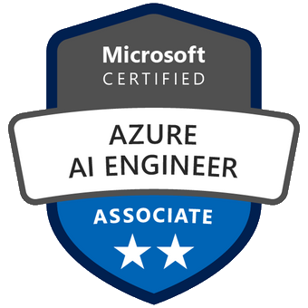
Exam AI-100: Designing and Implementing an Azure AI Solution Crash Course
Tim Warner

Slide 2
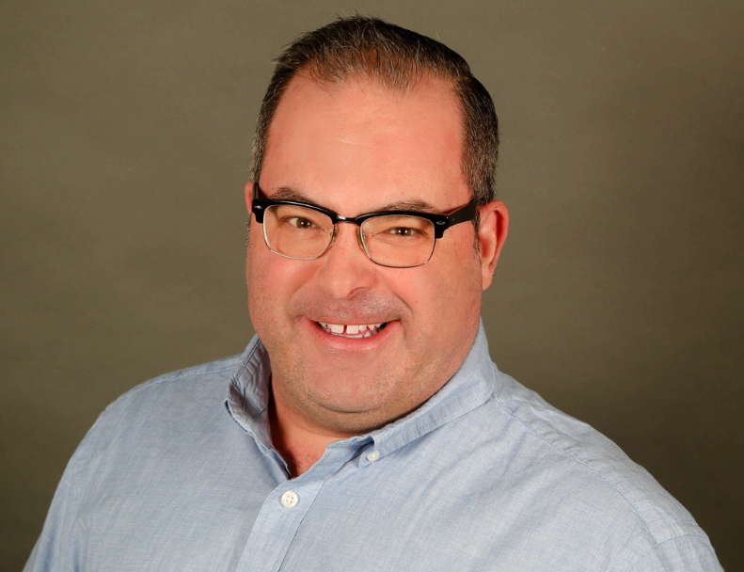

Tim Warner
Based in Nashville, TN, US
MCT, MVP
Twitter: @TechTrainerTim
Badge: timw.info

Slide 3
Course Materials
timw.info/ai100

Slide 4
Session 1 of 2 Learning Goals
Introduction
Fundamental Terminology
Azure AI Technology Stack Overview
Azure Machine Learning
Azure Cognitive Services

Slide 5
Session 2 of 2 Learning Goals
Azure Bot Service
Creating and Deploying Bots
Monitoring Azure AI Solutions
AI-100 Exam Strategy

Slide 6
Setting Expectations
This is a "crash course"
Plan to review these materials more than once
Five-minute break at midpoint
Please ask/answer questions and provide feedback in the Q/A panel, not the group chat

Slide 7
Tim's Certification Study Pyramid
Interdependence
Content knowledge
Practical application
Test-taking skills

Slide 8
Fundamental Terminology

Slide 9
Artificial Intelligence (AI)
Any technique that enables computers to mimic human intelligence

Slide 10
Machine Learning (ML)
Subset of AI that includes techniques that enable machines to improve at tasks with experience.
Supervised
Regression (prediction)
Classification
Unsupervised
Clustering

Slide 11
REST API
Service endpoints that support HTTP methods
Create, Read, Update, Delete

Slide 12
Azure AI Technology Stack Overview

Slide 13
Azure AI Stack
Apache Spark on Azure (MMLSpark)
HDInsight
Databricks
Azure Machine Learning
Azure Cognitive Services
Azure Cognitive Search
Azure Bot Service

Slide 14
Azure Machine Learning

Slide 15
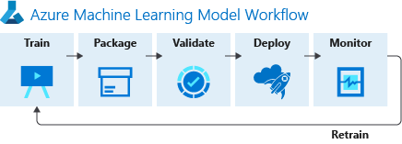
https://timw.info/f82d3

Slide 16
Azure Cognitive Services

Slide 17
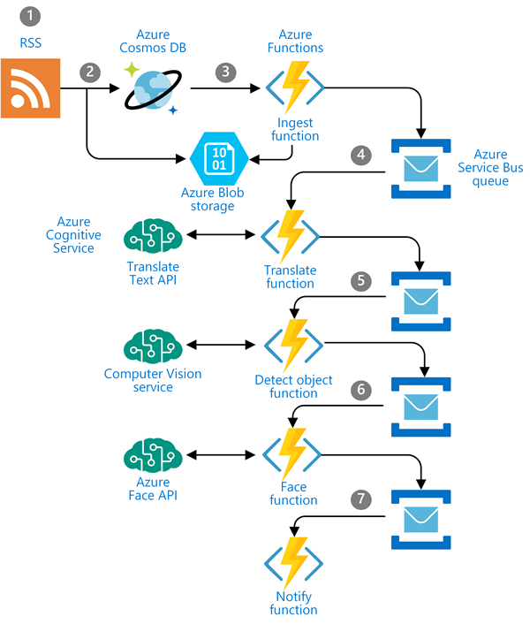
Use Case: Newsfeed Ingestion
https://timw.info/c0015

Slide 18
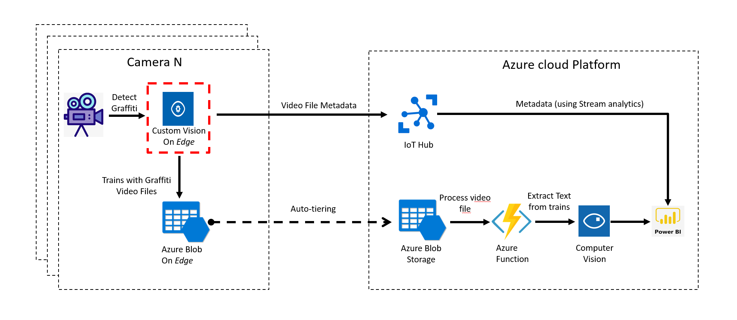
Use Case: IoT
https://timw.info/3f2c0

Slide 19
Azure Bot Service

Slide 20
Monitoring Azure AI Solutions

Slide 21
Exam AI-100 Strategy

Slide 22
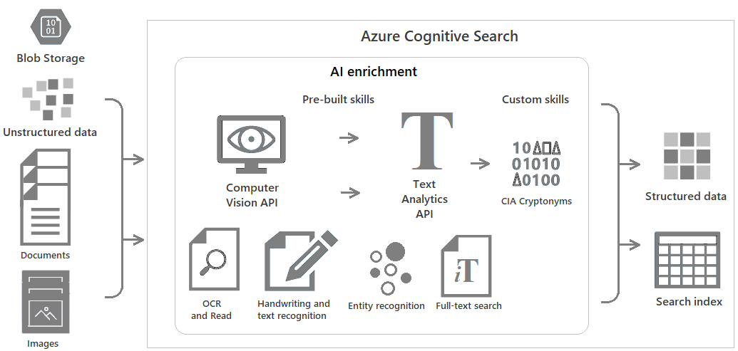
Azure Cognitive Search
https://timw.info/c6ab1

Slide 23
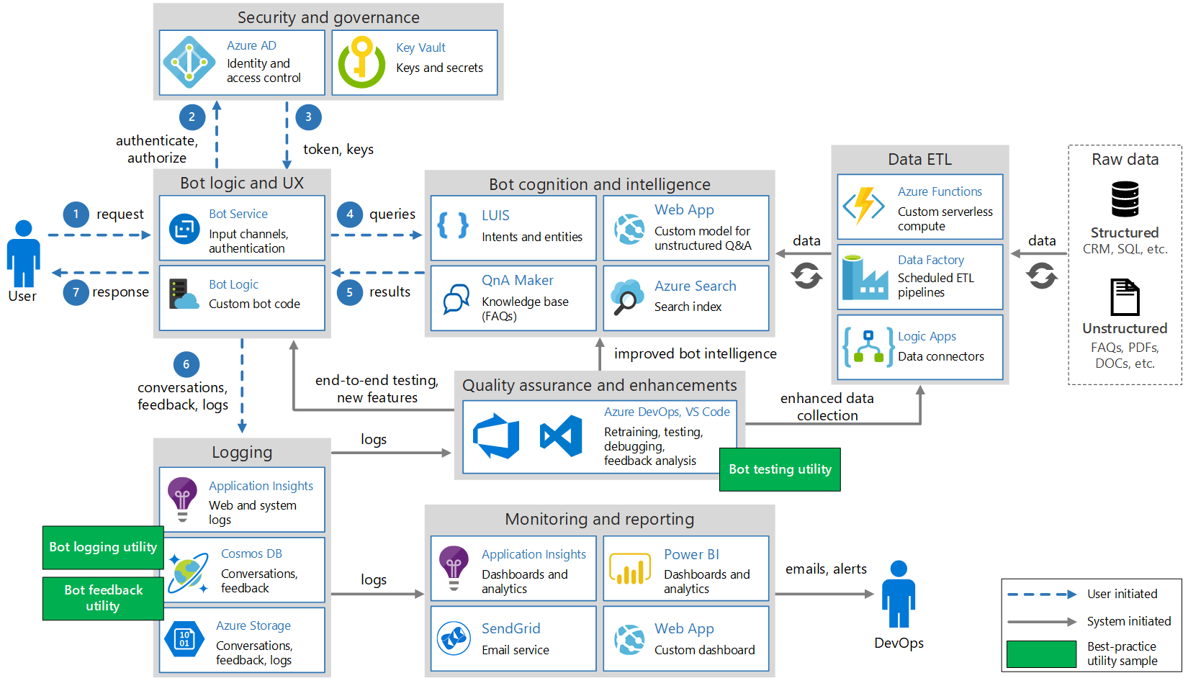
Conversational Bot
https://timw.info/32e9e

Slide 24
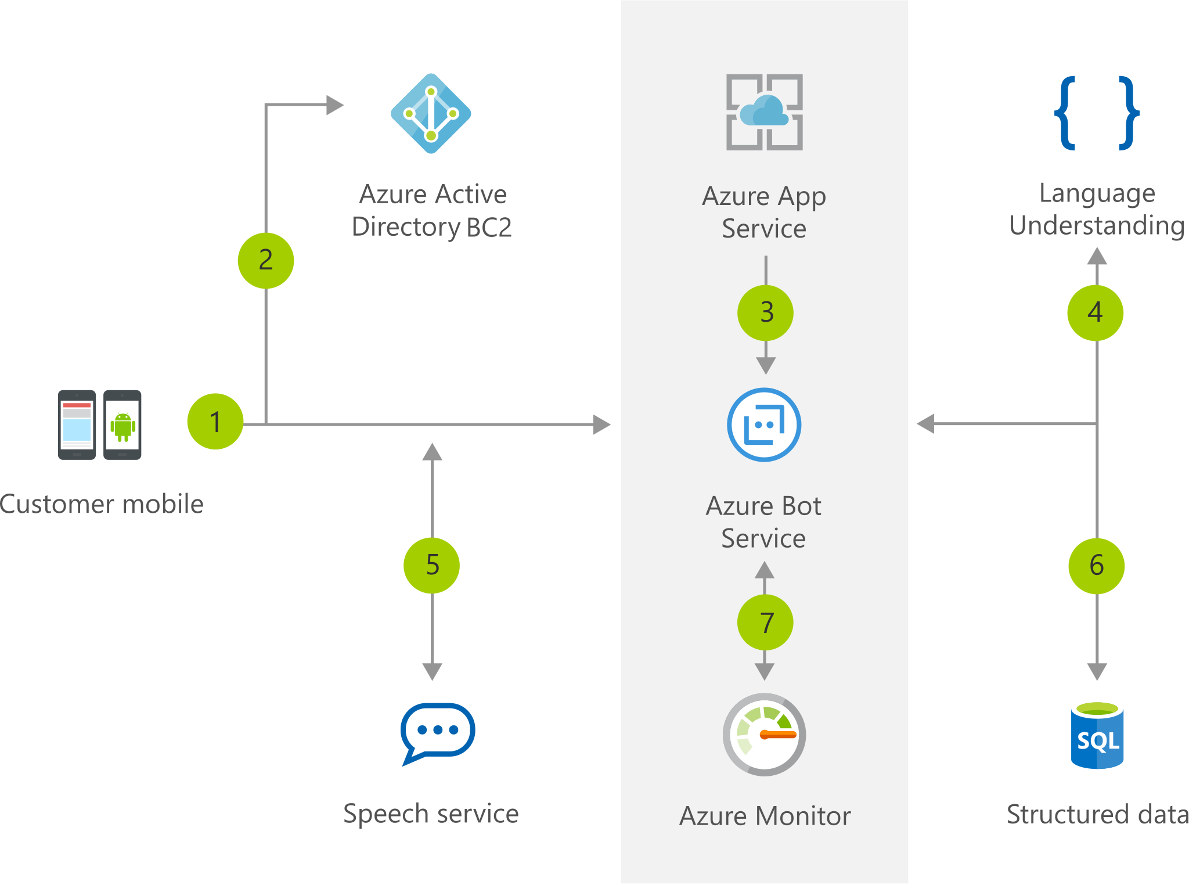
Chatbot
https://timw.info/b04eb

Slide 25
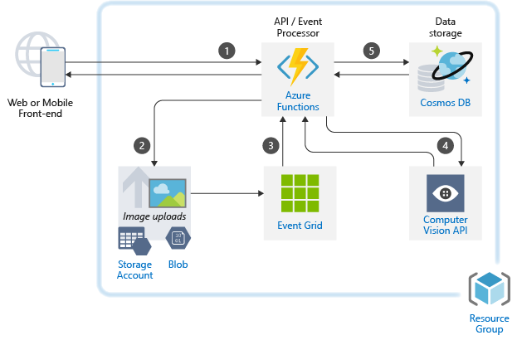
Image Classification
https://timw.info/caa25

Slide 26
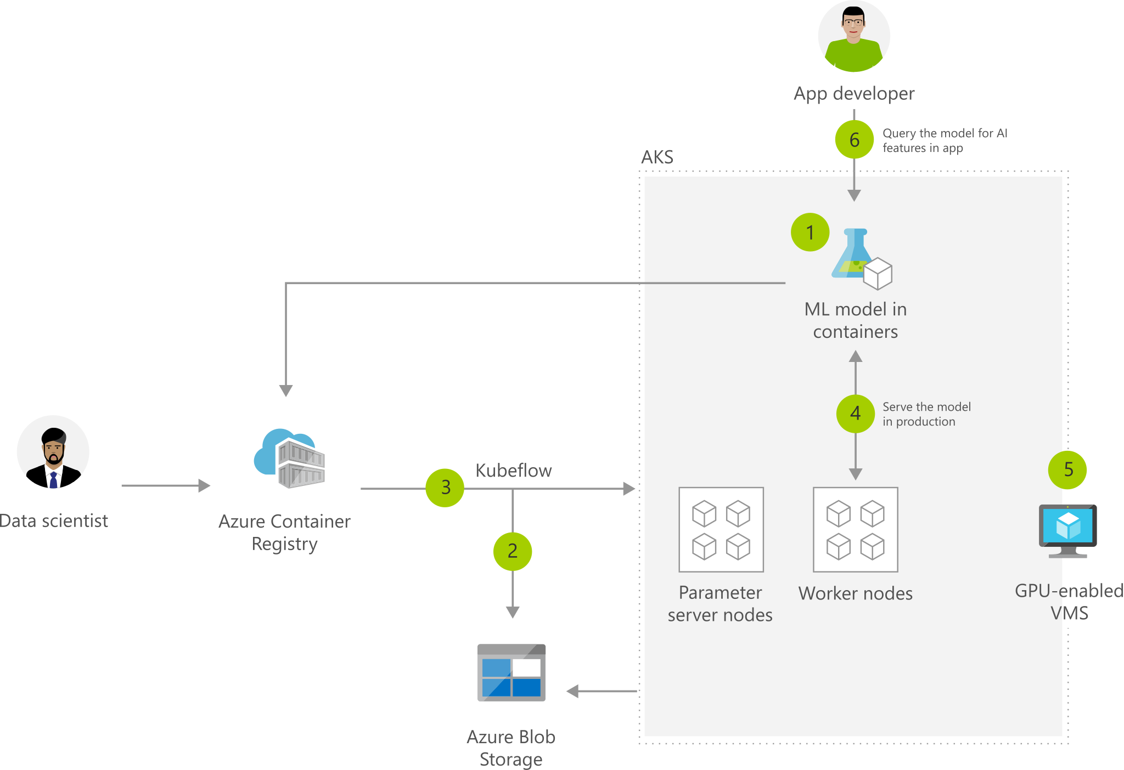
Machine Learning with AKS
https://timw.info/2b505

Slide 27
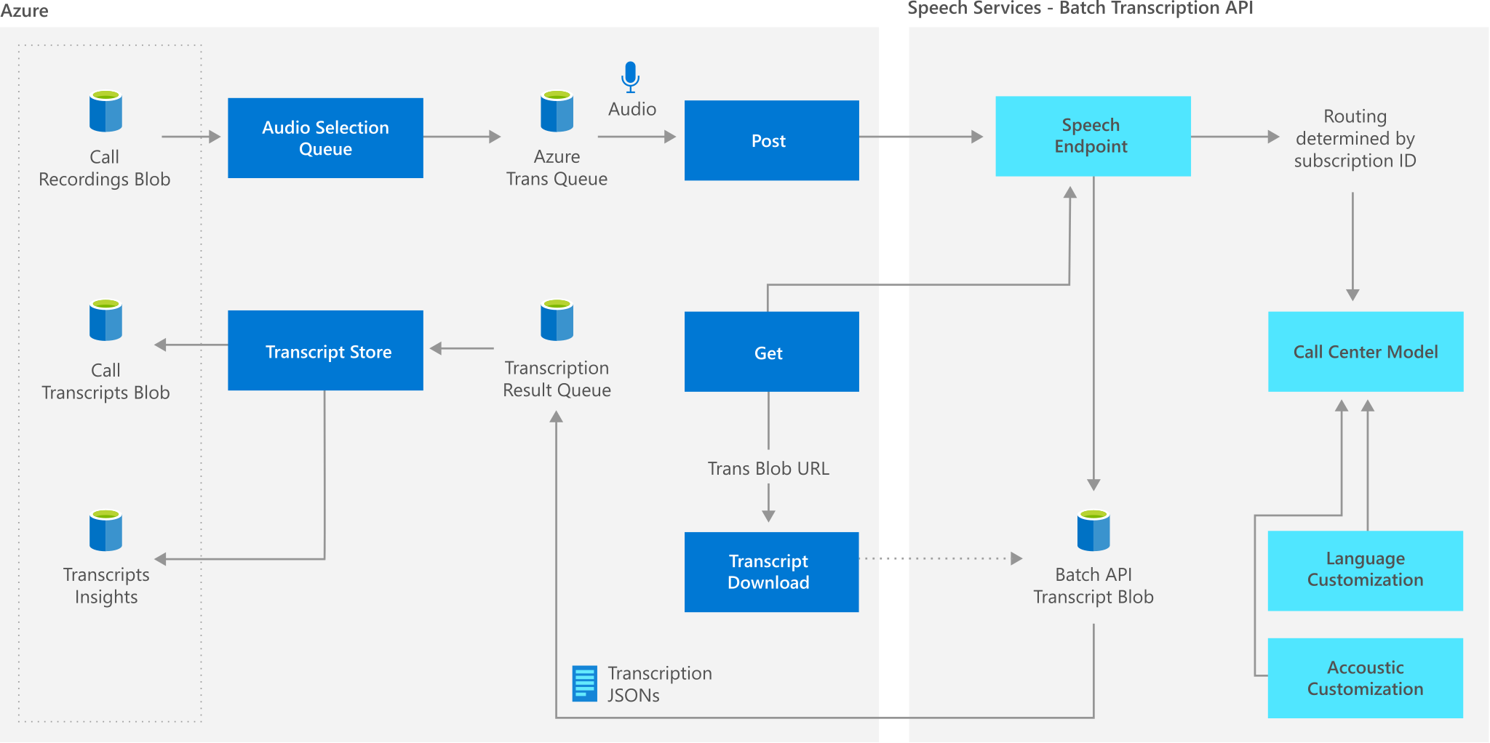
Speech Services
https://timw.info/9b1bc

Slide 28
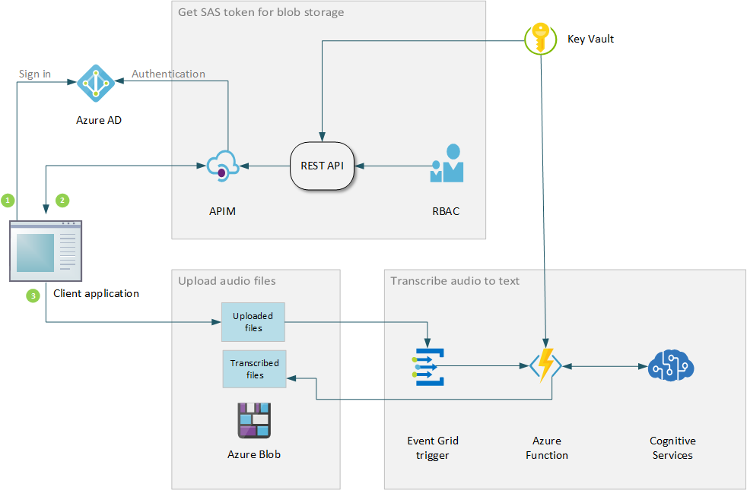
Speech Transcription
https://timw.info/59036

Slide 29
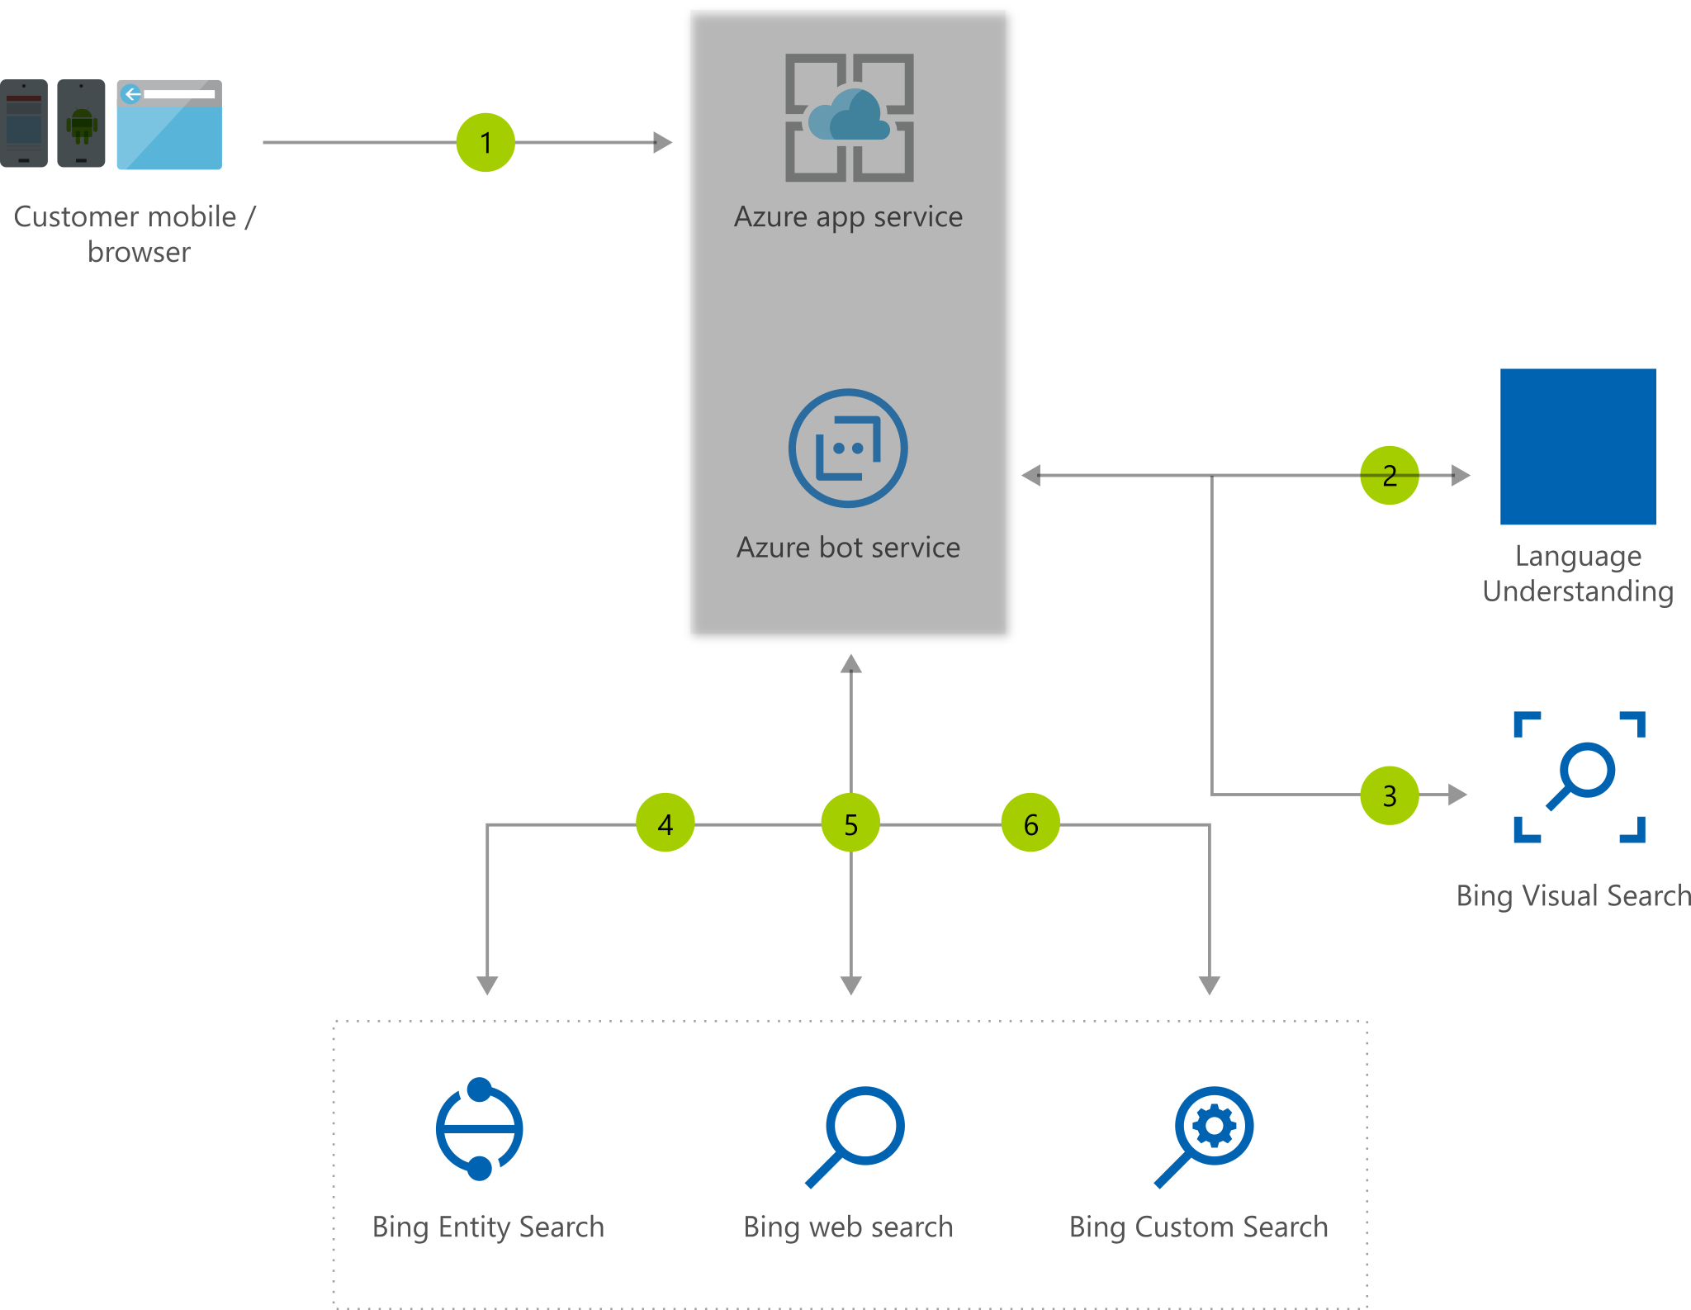
Visual Assistant
https://timw.info/380d7

Slide 30
Slide Title
timw.info/abcxy

Slide 31
Exam AI-100 Strategy

Slide 32
Tim's Certification Study Pyramid
Interdependence
Content knowledge
Practical application
Test-taking skills

Slide 33
Item Types

Slide 34

Single Answer Multiple Choice

Slide 35

Multiple Answer Multiple Choice

Slide 36
Repeated Scenario
You need to move an Azure VM to another hardware host.
Solution: You redeploy the VM.
Does this solution meet the goal?
Yes
No

Slide 37
Repeated Scenario
You need to move an Azure VM to another hardware host.
Solution: You enable boot diagnostics.
Does this solution meet the goal?
Yes
No

Slide 38

Select and Place

Slide 39

Build List and Reorder

Slide 40

Active Screen/Fill in the Blank

Slide 41

Case Study

Slide 42






Performance-Based Lab

Slide 43
Microsoft Online Testing

Slide 44
Tim's Online Testing Video (YouTube)
timw.info/online

Slide 45

Microsoft Online Testing Process

Slide 46

Microsoft Online Testing Process

Slide 47

Microsoft Online Testing Process

Slide 48

Microsoft Online Testing Process

Slide 49

Microsoft Online Testing Process

Slide 50

Microsoft Online Testing Process

Slide 51

Microsoft Online Testing Process

Slide 52
Thank you!
Course materials: timw.info/ai100
Twitter: @TechTrainerTim
Work: timw.info/ps
Web: timw.info

